Slide 1

Music Recommendation System

Slide 2

Agenda
1.Introduction
2. Project Overview
3. Dataset Description
4. Data Visualization
5. Data Preprocessing
6. Tools and Technologies Used
7. Business Case
8. Challenges Faced
9. Proposed Solution
10. Contributions
11. Target Problem
12. Performance Evaluation
13. Conclusion

Slide 3

1.Introduction
Today, I am here to present our project on the development of a Music Recommendation System.
Music recommendation systems have gained immense popularity in recent years due to the exponential growth of digital music platforms.
These systems aim to provide personalized recommendations to users based on their music preferences and behavior.
In this presentation, I will walk you through the process of building a music recommendation system, the challenges faced, and the proposed solution to enhance user experience and engagement.

Slide 4

2.Project Overview:
Our project focuses on developing an advanced music recommendation system using machine learning techniques.
The system analyzes user behavior, historical data, and music metadata to generate accurate and personalized recommendations.

Slide 5
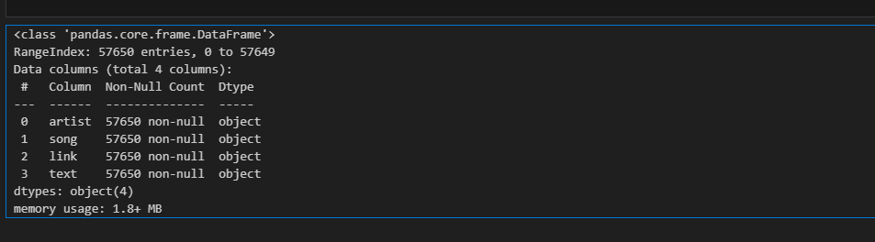
3.Dataset Description
Before diving into the details, let's take a look at the dataset we used for this project.
The dataset consists of a collection of songs, along with their associated metadata such as artist, song title, lyrics, and other relevant information
. Initially, the dataset contains 57650 rows and 4 columns.

Slide 6
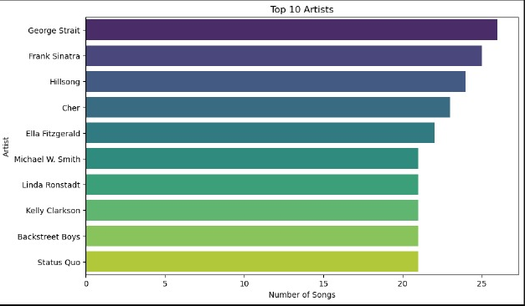
4.Data Visualization
Top 10 artist

Slide 7
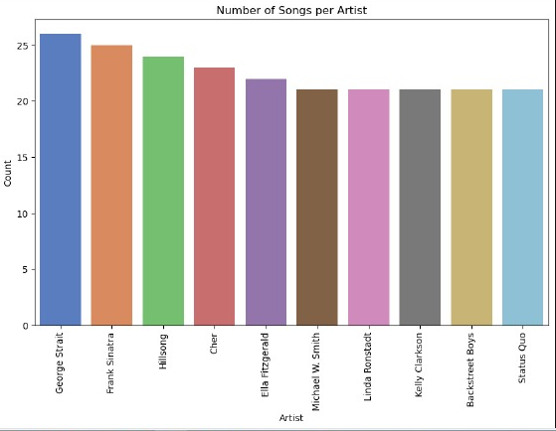
Number of songs per artist

Slide 8
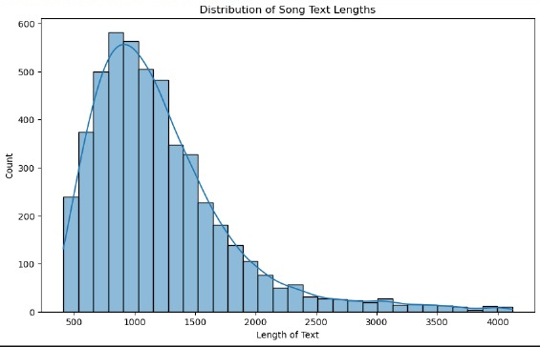
Distribution of songs lengths

Slide 9
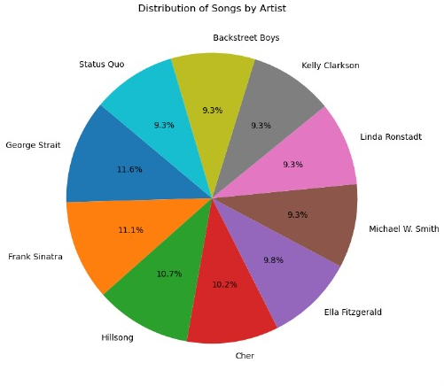
Distribution of songs by artist.

Slide 10
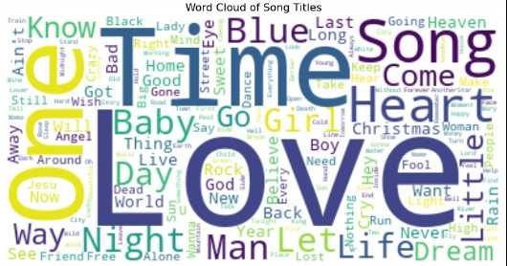
Most common words in the dataset

Slide 11

5.Data Preprocessing
To ensure the quality and reliability of our recommendation system, we performed extensive data preprocessing on the dataset.
This involved cleaning the data, handling missing values, removing duplicates, and transforming the data into a suitable format for analysis.

Slide 12

6.Tools and Technologies Used
Throughout the project, we utilized a range of tools and technologies to develop and implement the music recommendation system.
These include Python programming language.
1. Pandas for data manipulation.
2. Numpy: It provides powerful tools and functions for efficiently working with arrays and numerical data.
3. scikit-learn for machine learning algorithms.
4. Various data visualization libraries such as seaborn and matplotlib.
5.Nltk It is widely used in natural language processing (NLP) and text analysis tasks

Slide 13

7.Business Case
The primary objective of our music recommendation system is to enhance user satisfaction and engagement on digital music platforms.
By providing personalized song recommendations based on individual preferences, we aim to improve user retention, increase user interaction, and ultimately drive revenue growth for music streaming services.

Slide 14
8.Challenges Faced
During the development of the music recommendation system, we encountered several challenges.
These include handling large-scale datasets, dealing with sparse data, addressing the cold start problem for new users, and ensuring scalability and real-time performance of the recommendation algorithm.

Slide 15

9.Proposed Solution
To overcome these challenges, we implemented a hybrid recommendation approach that combines collaborative filtering and content-based filtering techniques.
This hybrid approach leverages both user behavior patterns and song characteristics to generate accurate and diverse recommendations for users.

Slide 16

10.Contributions
Our project makes the following contributions:
1. Developed a robust music recommendation system using state-of-the-art machine learning techniques.
2. Implemented a hybrid recommendation approach to improve recommendation accuracy and diversity.
3. Addressed the challenges of handling large-scale datasets, sparse data, and the cold start problem.
4. Enhanced user satisfaction and engagement on digital music platforms.

Slide 17
11.Target Problem
The target problem of our project is to recommend relevant and personalized songs to users based on their preferences and behavior.
By understanding user preferences and leveraging machine learning algorithms, we aim to provide accurate and timely recommendations that align with users' tastes and interests.

Slide 18

12.Performance Evaluation
To evaluate the performance of our music recommendation system, we employed various metrics such as precision, recall, and mean average precision.
Additionally, we conducted user feedback surveys and analyzed user engagement metrics to assess the system's effectiveness in improving user satisfaction and interaction.

Slide 19
13.Conclusion
In conclusion, our music recommendation system offers a powerful solution to enhance the user experience on digital music platforms.
By leveraging machine learning techniques and analyzing user behavior patterns, we can provide accurate and personalized song recommendations, ultimately leading to increased user satisfaction, engagement, and revenue growth.

Slide 20

Thank you for your attention
I am happy to answer any questions you may have.
mabdelmoneim678@gmail.com

